Slide 1
Mobile Handset Cellular Network
mskaiser@juniv.edu

Slide 2
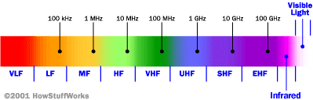
Cellular Network Basics
There are many types of cellular services; before delving into details, focus on basics (helps navigate the “acronym soup”)
Cellular network/telephony is a radio-based technology; radio waves are electromagnetic waves that antennas propagate
Most signals are in the 850 MHz, 900 MHz, 1800 MHz, and 1900 MHz frequency bands
Cell phones operate in this frequency range (note the logarithmic scale)

Slide 3
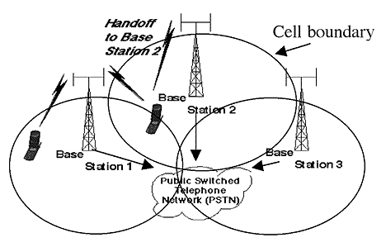
Cellular Network
Base stations transmit to and receive from mobiles at the assigned spectrum
  Multiple base stations use the same spectrum (spectral reuse)
The service area of each base station is called a cell
Each mobile terminal is typically served by the ‘closest’ base stations
  Handoff when terminals move

Slide 4
Cellular Network Generations
It is useful to think of cellular Network/telephony in terms of generations:
  0G: Briefcase-size mobile radio telephones
  1G: Analog cellular telephony
  2G: Digital cellular telephony
  3G: High-speed digital cellular telephony (including video telephony)
  4G: IP-based “anytime, anywhere” voice, data, and multimedia telephony at faster data rates than 3G
  (to be deployed in 2012–2015)

Slide 5
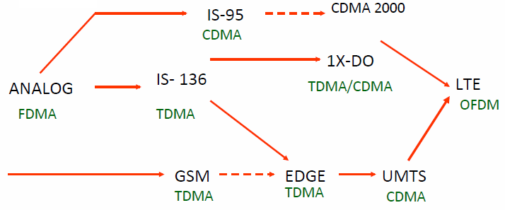
Evolution of Cellular Networks
1G
2G
2.5G
3G
4G

Slide 6
The Multiple Access Problem
The base stations need to serve many mobile terminals at the same time (both downlink and uplink)
All mobiles in the cell need to transmit to the base station
Interference among different senders and receivers
So we need multiple access scheme

Slide 7
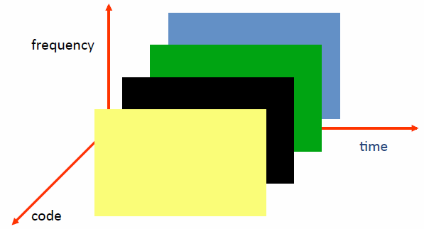
Multiple Access Schemes
3 orthogonal Schemes:
Frequency Division Multiple Access (FDMA)
Time Division Multiple Access (TDMA)
Code Division Multiple Access (CDMA)

Slide 8
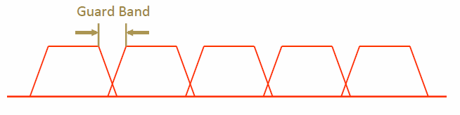
Frequency Division Multiple Access
frequency
Each mobile is assigned a separate frequency channel for the duration of the call
Sufficient guard band is required to prevent adjacent channel interference
Usually, mobile terminals will have one downlink frequency band and one uplink frequency band
Different cellular network protocols use different frequencies
Frequency is a precious and scare resource. We are running out of it
  Cognitive radio

Slide 9
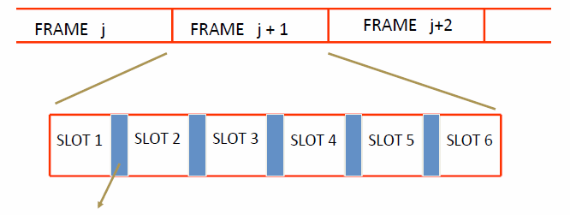
Time Division Multiple Access
Guard time – signal transmitted by mobile terminals at different locations do no arrive at the base station at the same time
Time is divided into slots and only one mobile terminal transmits during each slot
  Like during the lecture, only one can talk, but others may take the floor in turn
Each user is given a specific slot. No competition in cellular network
  Unlike Carrier Sensing Multiple Access (CSMA) in WiFi

Slide 10
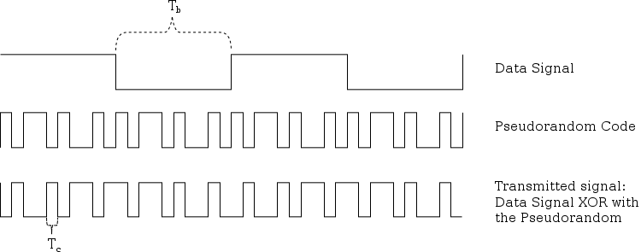
Code Division Multiple Access
Use of orthogonal codes to separate different transmissions
Each symbol of bit is transmitted as a larger number of bits using the user specific code – Spreading
  Bandwidth occupied by the signal is much larger than the information transmission rate
  But all users use the same frequency band together
Orthogonal among users

Slide 11
2G(GSM)

Slide 12
GSM
Abbreviation for Global System for Mobile Communications
Concurrent development in USA and Europe in the 1980’s
The European system was called GSM and deployed in the early 1990’s

Slide 13
GSM Services
    Voice, 3.1 kHz
Short Message Service (SMS)
  1985 GSM standard that allows messages of at most 160 chars. (incl. spaces) to be sent between handsets and other stations
  Over 2.4 billion people use it; multi-billion $ industry
General Packet Radio Service (GPRS)
  GSM upgrade that provides IP-based packet data transmission up to 114 kbps
  Users can “simultaneously” make calls and send data
  GPRS provides “always on” Internet access and the Multimedia Messaging Service (MMS) whereby users can send rich text, audio, video messages to each other
  Performance degrades as number of users increase
  GPRS is an example of 2.5G telephony – 2G service similar to 3G

Slide 14


GSM Channels
Channels
Downlink
Uplink
Physical Channel: Each timeslot on a carrier is referred to as a physical channel
Logical Channel: Variety of information is transmitted between the MS and BTS. Different types of logical channels:
  Traffic channel
  Control Channel

Slide 15
GSM Frequencies
Originally designed on 900MHz range, now also available on 800MHz, 1800MHz and 1900 MHz ranges.
Separate Uplink and Downlink frequencies
  One example channel on the 1800 MHz frequency band, where RF carriers are space every 200 MHz
UPLINK FREQUENCIES
DOWNLINK FREQUENCIES
1710 MHz
1785 MHz
1805 MHz
1880 MHz
UPLINK AND DOWNLINK FREQUENCY SEPARATED BY 95MHZ

Slide 16
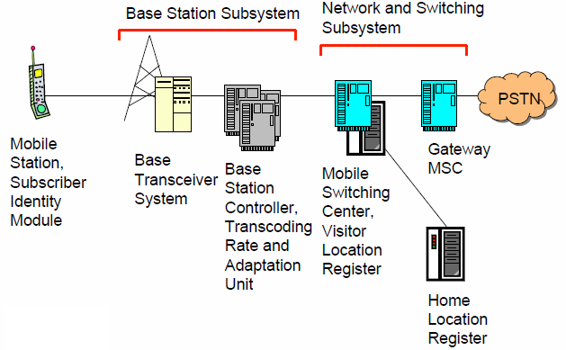
GSM Architecture

Slide 17
Mobile Station (MS)
MS is the user’s handset and has two parts
Mobile Equipment
  Radio equipment
  User interface
  Processing capability and memory required for various tasks
    Call signalling
    Encryption
    SMS
  Equipment IMEI number
Subscriber Identity Module

Slide 18
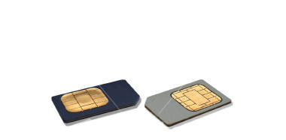
Subscriber Identity Module
A small smart card
Encryption codes needed to identify the subscriber
Subscriber IMSI number
Subscriber’s own information (telephone directory)
Third party applications (banking etc.)
Can also be used in other systems besides GSM, e.g., some WLAN access points accept SIM based user authentication

Slide 19
Base Station Subsystem
Transcoding Rate and Adaptation Unit (TRAU)
  Performs coding between the 64kbps PCM coding used in the backbone network and the 13 kbps coding used for the Mobile Station (MS)
Base Station Controller (BSC)
  Controls the channel (time slot) allocation implemented by the BTSes
  Manages the handovers within BSS area
  Knows which mobile stations are within the cell and informs the MSC/VLR about this
Base Transceiver System (BTS)
  Controls several transmitters
  Each transmitter has 8 time slots, some used for signaling, on a specific frequency

Slide 20
Network and Switching Subsystem
The backbone of a GSM network is a telephone network with additional cellular network capabilities
Mobile Switching Center (MSC)
  An typical telephony exchange (ISDN exchange) which supports mobile communications
  Visitor Location Register (VLR)
    A database, part of the MSC
    Contains the location of the active Mobile Stations
Gateway Mobile Switching Center (GMSC)
  Links the system to PSTN and other operators
Home Location Register (HLR)
  Contain subscriber information, including authentication information in Authentication Center (AuC)
Equipment Identity Register (EIR)
  International Mobile Station Equipment Identity (IMEI) codes for e.g., blacklisting stolen phones

Slide 21
Home Location Register
One database per operator
Contains all the permanent subscriber information
  MSISDN (Mobile Subscriber ISDN number) is the telephone number of the subscriber
  International Mobile Subscriber Identity (IMSI) is a 15 digit code used to identify the subscriber
    It incorporates a country code and operator code
  IMSI code is used to link the MSISDN number to the subscriber’s SIM (Subscriber Identity Module)
  Charging information
  Services available to the customer
Also the subscriber’s present Location Area Code, which refers to the MSC, which can connect to the MS.

Slide 22
Other Systems
Operations Support System
  The management network for the whole GSM network
  Usually vendor dependent
  Very loosely specified in the GSM standards
Value added services
  Voice mail
  Call forwarding
  Group calls
Short Message Service Center
  Stores and forwards the SMS messages
  Like an E-mail server
  Required to operate the SMS services

Slide 23
Location Updates
The cells overlap and usually a mobile station can ‘see’ several transceivers (BTSes)
The MS monitors the identifier for the BSC controlling the cells
When the mobile station reaches a new BSC’s area, it requests an location update
The update is forwarded to the MSC, entered into the VLR, the old BSC is notified and an acknowledgement is passed back

Slide 24
Handoff (Handover)
When a call is in process, the changes in location need special processing
Within a BSS, the BSC, which knows the current radio link configuration (including feedbacks from the MS), prepares an available channel in the new BTS
The MS is told to switch over to the new BTS
This is called a hard handoff
  In a soft handoff, the MS is connected to two BTSes simultaneously

Slide 25
Roaming
When a MS enters another operators network, it can be allowed to use the services of this operator
  Operator to operator agreements and contracts
  Higher billing
The MS is identified by the information in the SIM card and the identification request is forwarded to the home operator
  The home HLR is updated to reflect the MS’s current location

Slide 26
3G, 3.5G and 4G (LTE)

Slide 27
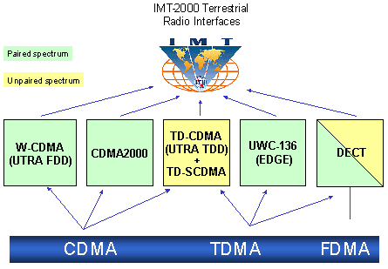
3G Overview
3G is created by ITU-T and is called IMT-2000

Slide 28
Evolution from 2G
2G
IS-95
GSM-
IS-136 & PDC
GPRS
2.5G
IS-95B
HSCSD
EDGE
Cdma2000-1xRTT
W-CDMA
3G
Cdma2000-1xEV,DV,DO
EDGE
Cdma2000-3xRTT
TD-SCDMA
3GPP2
3GPP

Slide 29
Service Roadmap
3G-specific services take advantage of higher bandwidth and/or real-time QoS
Broadband
in wide area
Video sharing
Video telephony
Real-time IP
multimedia and games
Multicasting
A number of mobile services are bearer independent in nature
Multitasking
WEB browsing
Corporate data access
Streaming audio/video
MMS picture / video
xHTML browsing
Application downloading
E-mail
Voice & SMS
Presence/location
Push-to-talk
Typical average bit rates
(peak rates higher)
GSM
9.6
kbps
GPRS
171
kbps
EGPRS
473
kbps
WCDMA
2
Mbps
HSDPA
1-10
Mbps
CDMA
2000 1x
CDMA
2000-EVDO
CDMA
2000-EVDV
Improved performance, decreasing cost of delivery

Slide 30
GSM Evolution to 3G
High Speed Circuit Switched Data
Dedicate up to 4 timeslots for data connection ~ 50 kbps
Good for real-time applications c.w. GPRS
Inefficient -> ties up resources, even when nothing sent
Not as popular as GPRS (many skipping HSCSD)
Enhanced Data Rates for Global Evolution
Uses 8PSK modulation
3x improvement in data rate on short distances
Can fall back to GMSK for greater distances
Combine with GPRS (EGPRS) ~ 384 kbps
Can also be combined with HSCSD
GSM
9.6kbps (one timeslot)
GSM Data
Also called CSD
HSCSD
GSM
GPRS
WCDMA
General Packet Radio Services
Data rates up to ~ 115 kbps
Max: 8 timeslots used as any one time
Packet switched; resources not tied up all the time
Contention based. Efficient, but variable delays
GSM / GPRS core network re-used by WCDMA (3G)
EDGE

Slide 31
UMTS
Universal Mobile Telecommunications System (UMTS)
UMTS is an upgrade from GSM via GPRS or EDGE
The standardization work for UMTS is carried out by Third Generation Partnership Project (3GPP)
Data rates of UMTS are:
  144 kbps for rural
  384 kbps for urban outdoor
  2048 kbps for indoor and low range outdoor
Virtual Home Environment (VHE)

Slide 32
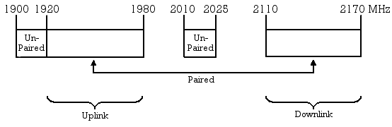
UMTS Frequency Spectrum
UMTS Band
  1900-2025 MHz and 2110-2200 MHz for 3G transmission
  In the US, 1710–1755 MHz and 2110–2155 MHz will be used instead, as the 1900 MHz band was already used.

Slide 33
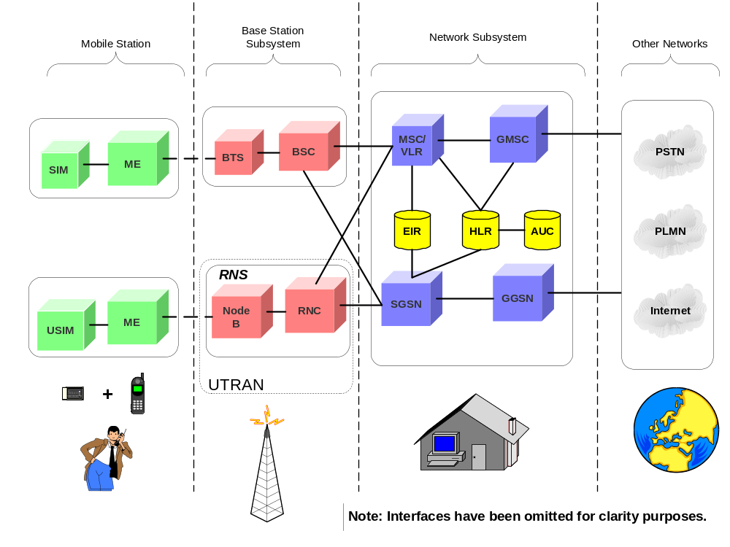
UMTS Architecture

Slide 34
UMTS Network Architecture
UMTS network architecture consists of three domains
  Core Network (CN): Provide switching, routing and transit for user traffic
  UMTS Terrestrial Radio Access Network (UTRAN): Provides the air interface access method for user equipment.
  User Equipment (UE): Terminals work as air interface counterpart for base stations. The various identities are: IMSI, TMSI, P-TMSI, TLLI (Temporary Logical Link Identifier)), MSISDN, IMEI, IMEISV ( International Mobile station Equipment Identity and Software Version Number)

Slide 35
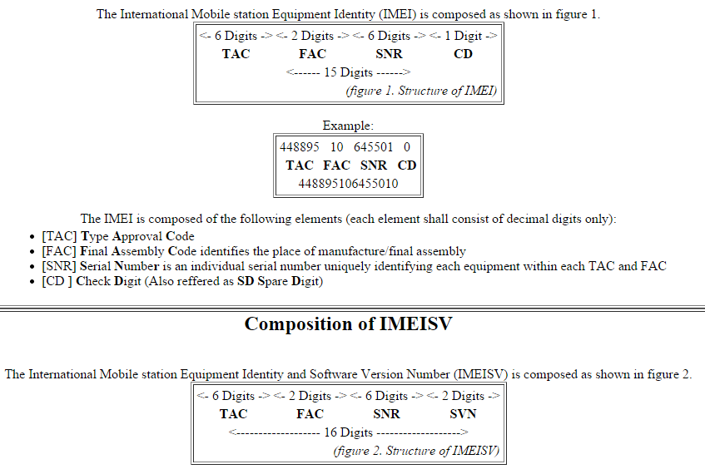

Slide 36
UTRAN
Wide band CDMA technology is selected for UTRAN air interface
  WCDMA
  TD-SCDMA
Base stations are referred to as Node-B and control equipment for Node-B is called as Radio Network Controller (RNC).
  Functions of Node-B are
    Air Interface Tx/Rx
    Modulation/Demodulation
  Functions of RNC are:
    Radio Resource Control
    Channel Allocation
    Power Control Settings
    Handover Control
    Ciphering
    Segmentation and reassembly

Slide 37
3G Overview

Slide 38
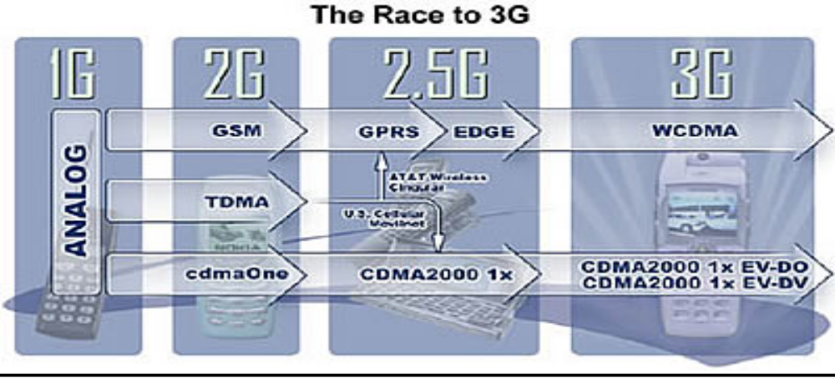
Route to 3G
1G: analog
2G : 1st digital mobile telephony
2.5G: transition from 2G to 3G
3G standard: IMT 2000

Slide 39
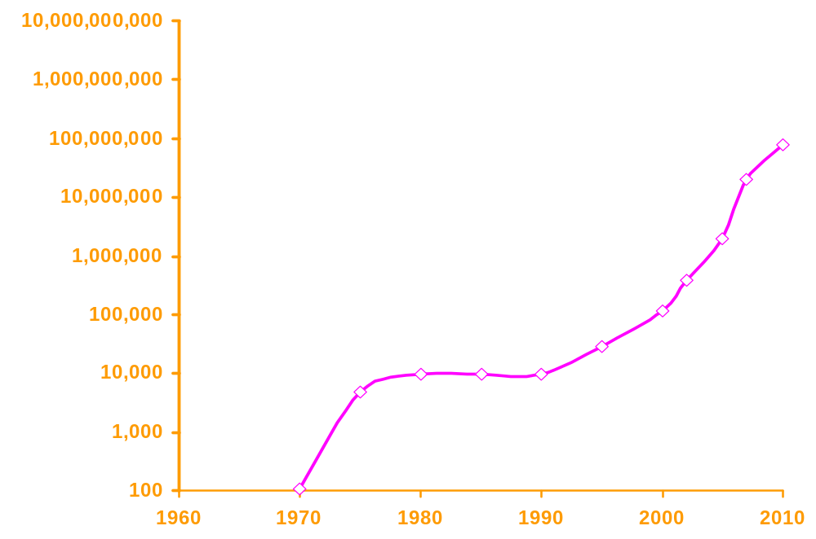
3G & Future Wireless Vs. Bandwidth
4G
3.5G
bps
3G
GPRS
2G

Slide 40
3G- Advantages
3G phones promise :-
Improved digital voice communications
Larger Bandwidth – Higher Data rate
Greater subscriber capacity
Fast packet-based data services like e-mail, short message service (SMS), and Internet access at broadband speeds.
Most carriers also expect consumers to want :-
  location services
  interactive gaming
  streaming video
  home monitoring and control
  and who knows what else, while being fully mobile anywhere in the world.

Slide 41
3G Capabilities
Voice quality comparable to the public switched telephone network
144 Kbps- user in high-speed motor vehicles
384 Kbps- pedestrians standing or moving slowly over small areas
Up to 2 Mbps- fixed applications like office use
Symmetrical/asymmetrical data transmission rates
Support for both packet switched and circuit switched data services like Internet Protocol (IP) traffic and real time video

Slide 42
Organizations
  3G is also known as UMTS (Universal Mobile Telecommunication System)
  3GPP 3rd Generation Partnership Project.
  3GPP2 3rd Generation Partnership Project 2
  Internet Engineering Taskforce (IETF)
  ITU-IMT-2000 Standard (International Telecommunication Union- International Mobile Telecommunication)

Slide 43
IMT-2000 Radio Interface
I M T
Paired Spectrum
Unpaired Spectrum
IMT-DS
UMTS-FDD
(WCDMA)
Direct spread
IMT-MC
CDMA-2000
(1x-EvDO/DV)
Multi carrier
IMT-TC
UMTS-TDD
(TD-SCDMA)
Time code
IMT-SC
UWC-136
(EDGE)
Single carrier
IMT-FT
DECT
Freq. time
CDMA TDMA FDMA

Slide 44
IMT-2000 Frequency Bands
1G + 2G
806
960 MHz
2G (Asia, Europe) + 3G
1710
1885 MHz
WCDMA(UL) 1820-1880MHz
WCDMA(DL) 1910-1970MHz
DECT, PHS + 2G + 3G
1885
2025
2110
2200 MHz
2500
2690 MHz

Slide 45
Technologies
3G is superior to the other digital standards like:-
  GSM (Global System for Mobile) communications standard used worldwide
  And IS-136 TDMA standard used primarily in North America.
3G Technologies:-
  WCDMA or UMTS-FDD (Universal Mobile Telecommunications System - Frequency Division Duplex)---Direct Spread
  CDMA2000 - 1x-EvDO/EvDV---Multi carrier
  UMTS – TDD (Time Division Duplex) or TD-SCDMA (Time Division - Synchronous Code Division Multiple Access) ---Time Code
4G Technologies:-
  Digital Audio Broadcast (DAB) and Digital Video Broadcast (DVB) for wide area broadcasting
  Local Multipoint Distribution System (LMDS)
  Microwave Multipoint Distribution System (MMDS)

Slide 46
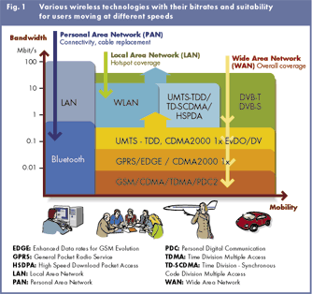
Wireless Technologies (Figure)

Slide 47

Evolution Paths
cdmaOne
IS-95B
cdmaOne
IS-95A
Cdma2000 1X
Cdma2000
1xEV-DO
TDMA
Cdma2000
1xEV-DV
IS-41 Core Network
EDGE
WCDMA
GSM
GPRS
GSM Map Core Network
2G
2.5G
3G

Slide 48
UMTS-FDD / WCDMA
(Universal Mobile Telecommunication Standard- Frequency Division Duplex)

Slide 49
UMTS-FDD / WCDMA
Wideband Direct Sequence Code Division
Multiple Access
Does not assign a specific frequency to each user. Instead every channel uses the full available spectrum. Individual conversations are encoded with a pseudo-random digital sequence
Narrowband option for TDD.

Slide 50
WCDMA Parameters
Channel B.W | 5 MHz
Forward RF Channel Structure | Direct Spread
Chip Rate | 3.84 Mcps
Frame Length | 10 ms (38400 chips)
No. of slots/frame | 15
No. of chips/slot | 2560chips (Max. 2560 bits)
Power Control | Open and fast close loop (1.6 KHz)
Uplink SF | 4 to 256
Downlink SF | 4 to 512

Slide 51
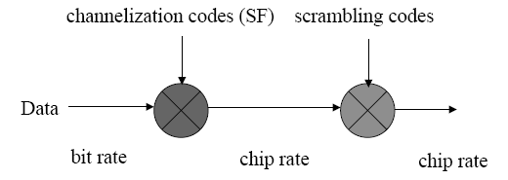
Spreading Operation
Spreading means increasing the signal bandwidth
Strictly speaking, spreading includes two operations:
(1) Channelisation (increases signal bandwidth)
- using orthogonal codes
(2) Scrambling (does not affect the signal bandwidth)
- using pseudo noise codes

Slide 52
Codes
 | Channellization Code | Scrambling Code
Usage | UL: Separation of physical data and control channels from same UE DL: Separation of different users within one cell | UL: Separation of terminals DL: Separation of cells/sectors
Length | UL:4-256 chips DL:4-512 chips | 38400 chips
No. of codes | No. of codes under one scrambling code= SF | UL: Several million DL: 512
Code Family | Orthogonal Variable Spreading Factor | Long 10ms code: Gold code Short code: Extended S(2) code Family
Increase B.W? | YES | NO

Slide 53
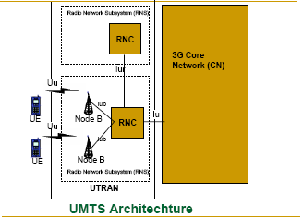
UMTS/IMT-2000 Architecture

Slide 54
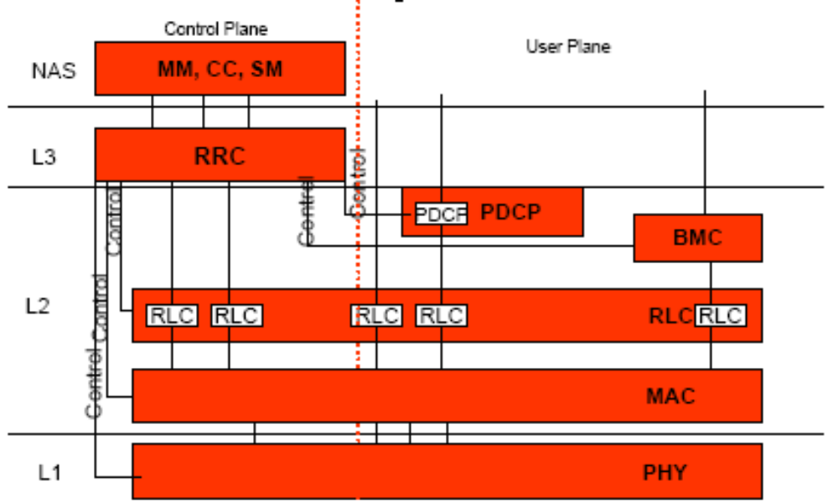
UMTS Protocol Stack

Slide 55
WCDMA : PHYSICAL Layer

Slide 56
Physical Layer
The physical layer offers information transfer services to the MAC layer. These services are denoted as Transport channels (TrCh’s). There are also Physical channels.
Physical layer comprises following functions:
  Various handover functions
  Error detection and report to higher layers
  Multiplexing of transport channels
  Mapping of transport channels to physical channels
  Fast Close loop Power control
  Frequency and Time Synchronization
  Other responsibilities associated with transmitting and receiving signals over the wireless media.

Slide 57
Transport & Physical Channels
Transport Channel | Physical Channel
(UL/DL) Dedicated Channel DCH | Dedicated Physical Data Channel DPDCH Dedicated Physical Control Channel DPCCH
(UL) Random Access Channel RACH | Physical random access channel PRACH
(UL) Common packet channel CPCH | Physical common packet channel PCPCH
(DL) Broadcast channel BCH | Primary common control physical channel P-CCPCH
(DL) Forward access channel FACH (DL) Paging channel PCH | Secondary common control physical channel S-CCPCH
(DL) Downlink shared channel DSCH | Physical downlink shared channel PDSCH
Signaling physical channels | Synchronization channel SCH Common pilot channel CPICH Acquisition indication channel AICH Paging indication channel PICH CPCH Status indication channel CSICH Collision detection/Channel assignment indicator channel CD/CA-ICH

Slide 58
WCDMA : MAC Layer

Slide 59
MAC Layer
The MAC layer offers Data transfer to RLC and higher layers.
The MAC layer comprises the following functions:
  Selection of appropriate TF (basically bit rate), within a predefined set, per information unit delivered to the physical layer
  Service multiplexing on RACH, FACH, and dedicated channels
  Priority handling between ‘data flows’ of one user as well as between data flows from several users—the latter being achieved by means of dynamic scheduling
  Access control on RACH
  Address control on RACH and FACH
  Contention resolution on RACH

Slide 60
WCDMA : RLC Layer

Slide 61
RLC Layer
The RLC layer offers the following services to the higher layers:
  Layer 2 connection establishment/release
  Transparent data transfer, i.e., no protocol overhead is appended to the information unit received from the higher layer
  Assured and un assured data transfer
The RLC layer comprises the following functions:
  Segmentation and assembly
  Transfer of user data
  Error correction by means of retransmission optimized for the WCDMA physical layer
  Sequence integrity (used by at least the control plane)
  Duplicate detection
  Flow control
  Ciphering

Slide 62
WCDMA : RRC Layer

Slide 63
RRC Layer
The RRC layer offers the core network the following services:
  General control service, which is used as an information broadcast service
  Notification service, which is used for paging and notification of a selected UEs
  Dedicated control service, which is used for establishment/release of a connection and transfer of messages using the connection.
The RRC layer comprises the following functions:
  Broadcasting information from network to all UEs
  Radio resource handling (e.g., code allocation, handover, admission control, and measurement reporting/control)
  QoS Control
  UE measurement reporting and control of the reporting
  Power Control, Encryption and Integrity protection

Slide 64
WCDMA : Hand Over

Slide 65
Hand Over
Intra-mode handover
  Include soft handover, softer handover and hard handover.
  Rely on the Ec/No measurement performed from the CPICH.
Inter-mode handover
  Handover to the UTRA TDD mode.
Inter-system handover
  Handover to other system, such as GSM.
  Make measurement on the frequency during compressed mode.

Slide 66
WCDMA : Power Control

Slide 67
Power Control
Fast Closed Loop PC – Inner Loop PC
  Feedback information.
  Uplink PC is used for near-far problem. Downlink PC is to ensure that there is enough power for mobiles at the cell edge.
Two special cases for fast closed loop PC:
  Soft handover:- how to react to multiple power control commands from several sources. At the mobile, a “power down” command has higher priority over “power up” command.
  Compressed mode:- Large step size is used after a compressed frame to allow the power level to converge more quickly to the correct value after the break.

Slide 68
Power Control (Contd.)
Open loop PC
  No feedback information.
  Make a rough estimate of the path loss by means of a downlink beacon signal.
  Provide a coarse initial power setting of the mobile at the beginning of a connection.
  Apply only prior to initiating the transmission on RACH or CPCH.

Slide 69
WCDMA : QoS Support

Slide 70
UMTS/WCDMA QoS
The standard provides an overview of the functionality needed to establish, modify and maintain a UMTS link with a specific QoS.
Divided into:
  Control plane
    Managing, translating, admitting and controlling users requests and network resources.
  User plane
    QoS signaling and monitoring of user data traffic

Slide 71
QoS Classes
Conversational (real time):-
  VoIP
  Telephony
  Video conferencing
Streaming (real time):-
  Video and audio streams
Interactive:-
  Web browsing
  Data retrieval
  Server access
Background:-
  Download of emails and files

Slide 72
What next after 3G?
3G &
WLAN &
Brdcst
3G &
WLAN &
Ad-hoc
4G &
WLAN &
Brdcst
The future path has fractured
into a number of possibilities
Operators and vendors must
create viable strategies to
prosper within this complexity
2.5G &
WLAN
?
3G+ &
WLAN &
Ad-hoc
4G &
WLAN &
Ad-hoc
3G &
WLAN
3G+ &
WLAN
GPRS/
EDGE
(2.5G)
4G &
WLAN
3G+
GSM
(2G)
W-CDMA
(3G)
4G
1990
2000
2010

Slide 73
4G Air Interface
Higher bit rates than 3G (20 Mbps < peak < 200 Mbps)
Higher spectral efficiency and Lower Cost per bit than 3G
Air interface and MAC optimized for IP traffic
  Adaptive modulation/coding with power control, hybrid ARQ
Smaller cells, on average, than 3G
  However, cell size will be made as large as possible via:
    High power base station to boost downlink range
    Asymmetry - used to boost uplink range when necessary
    Adaptive antennas option
Higher frequency band than 3G (below 5 GHz preferred)
RF channel bandwidths of 20 MHz and higher
Frequency Domain methods:
  OFDM is promising for downlink

Slide 74
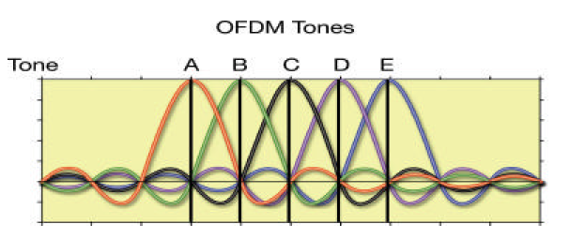
OFDM
Divides the spectrum into a number of equally spaced tones.
Each tone carries a portion of data.
A kind of FDMA, but each tone is orthogonal with every other tone. Tones can overlap each other.
Example: 802.11a WLAN
Notes:
Do not need frequency guard

Slide 75
Summary
3G wireless services are rapidly spreading the global market place with CDMA as the preferred technology solution
The following are the key 3G Technologies that have emerged to be the key commercial players:
  CDMA2000 1X
  CDMA2000 1xEV-DO
  UMTS/WCDMA
WCDMA is one of them, which provides:-
  Larger Bandwidth – Higher Data rate – Lower cost
  Greater subscriber capacity
  IMT-2000 Radio interface standard offers 3G standard
  Hand Over, Power Control problems are addressed
  QoS offered But Customers really want them?
4G still in a formative stage (commercial 2010)
Frequency bands less than 5 GHz preferred for wide-area, mobile services
4G system bandwidth between 20 and 100 MHz
Lower cost per bit than 3G

Slide 76
3.5G (HSPA)
High Speed Packet Access (HSPA) is an amalgamation of two mobile telephony protocols, High Speed Downlink Packet Access (HSDPA) and High Speed Uplink Packet Access (HSUPA), that extends and improves the performance of existing WCDMA protocols
3.5G introduces many new features that will enhance the UMTS technology in future. 1xEV-DV already supports most of the features that will be provided in 3.5G. These include:
- Adaptive Modulation and Coding
- Fast Scheduling
- Backward compatibility with 3G
- Enhanced Air Interface

Slide 77
4G (LTE)
LTE stands for Long Term Evolution
Next Generation mobile broadband technology
Promises data transfer rates of 100 Mbps
Based on UMTS 3G technology
Optimized for All-IP traffic

Slide 78
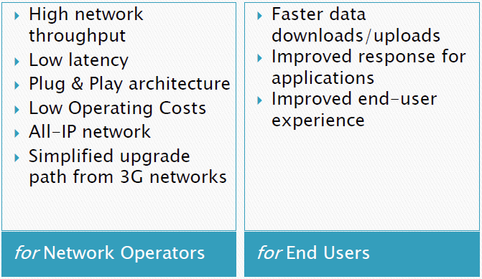
Advantages of LTE

Slide 79
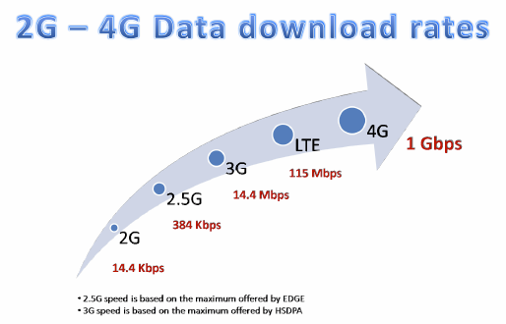
Comparison of LTE Speed

Slide 80
Major LTE Radio Technogies
Uses Orthogonal Frequency Division Multiplexing (OFDM) for downlink
Uses Single Carrier Frequency Division Multiple Access (SC-FDMA) for uplink
Uses Multi-input Multi-output(MIMO) for enhanced throughput
Reduced power consumption
Higher RF power amplifier efficiency (less battery power used by handsets)

Slide 81
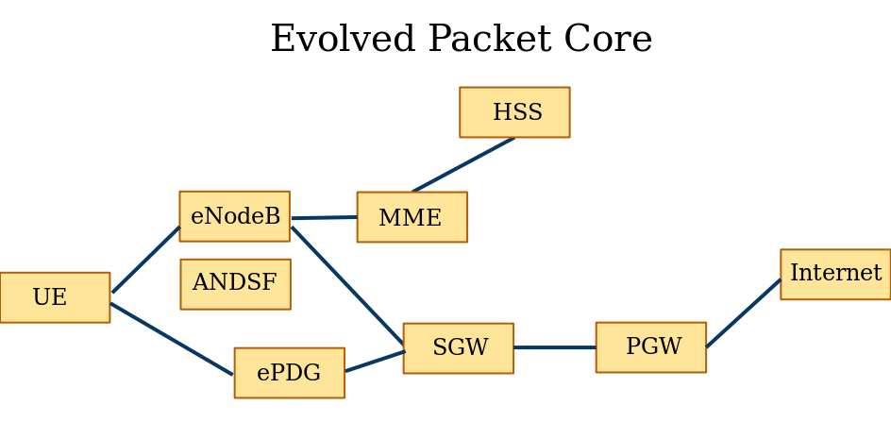

LTE Architecture

Slide 82
System Architecture Evolution ( SAE)
It is the core network architecture of 3GPP's LTE wireless communication standard.
SAE is the evolution of the GPRS Core Network, with some differences:
  simplified architecture
  all-IP Network (AIPN)
  support for higher throughput and lower latency radio access networks (RANs)
  support for, and mobility between, multiple heterogeneous access networks

Slide 83
MME (Mobility Management Entity):
The MME is the key control-node for the LTE access-network. It is responsible for idle mode UE (User Equipment) paging and tagging procedure including retransmissions.
It is involved in the bearer activation/deactivation process and is also responsible for choosing the SGW for a UE at the initial attach and at time of intra-LTE handover involving Core Network (CN) node relocation.
It is responsible for authenticating the user (by interacting with the HSS).

Slide 84
The MME is the termination point in the network for ciphering/integrity protection for NAS signaling and handles the security key management.
Lawful interception of signaling is also supported by the MME.
The MME also provides the control plane function for mobility between LTE and 2G/3G access networks with the S3 interface terminating at the MME from the SGSN.

Slide 85
SGW (Serving Gateway)
The SGW routes and forwards user data packets, while also acting as the mobility anchor for the user plane during inter-eNodeB handovers and as the anchor for mobility between LTE and other 3GPP technologies.
For idle state UEs, the SGW terminates the downlink data path and triggers paging when downlink data arrives for the UE. It manages and stores UE contexts, e.g. parameters of the IP bearer service, network internal routing information. It also performs replication of the user traffic in case of lawful interception.

Slide 86
PGW (PDN Gateway)
The PDN Gateway provides connectivity from the UE to external packet data networks by being the point of exit and entry of traffic for the UE.
A UE may have simultaneous connectivity with more than one PGW for accessing multiple PDNs.
The PGW performs policy enforcement, packet filtering for each user, charging support, lawful interception and packet screening.

Slide 87
HSS (Home Subscriber Server)
The HSS is a central database that contains user-related and subscription-related information.
The functions of the HSS include functionalities such as mobility management, call and session establishment support, user authentication and access authorization.
The HSS is based on pre-Rel-4Home Location Register (HLR) and Authentication Center (AuC).

Slide 88
ANDSF (Access Network Discovery and Selection Function)
The ANDSF provides information to the UE about connectivity to 3GPP and non-3GPP access networks (such as Wi-Fi).
The purpose of the ANDSF is to assist the UE to discover the access networks in their vicinity and to provide rules (policies) to prioritize and manage connections to these networks.

Slide 89
ePDG (Evolved Packet Data Gateway)
The main function of the ePDG is to secure the data transmission with a UE connected to the EPC over an untrusted non-3GPP access.
For this purpose, the ePDG acts as a termination node of IPsec tunnels established with the UE.

Slide 90
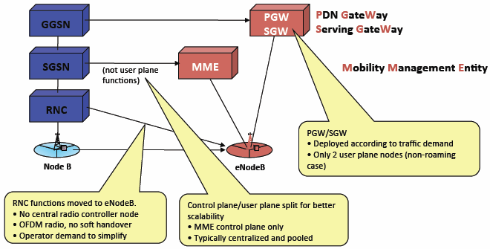
LTE vs UMTS
Functional changes compared to the current UMTS architecture

